Slide 1
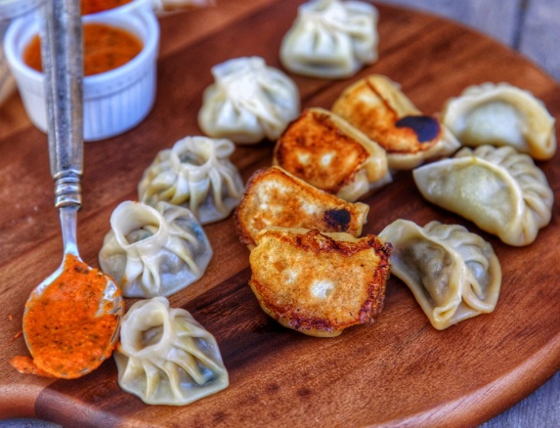
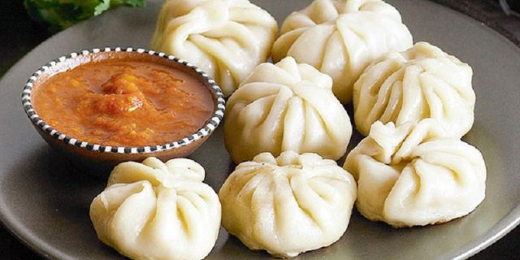
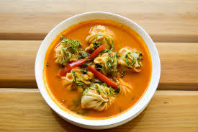
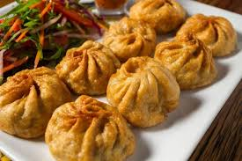
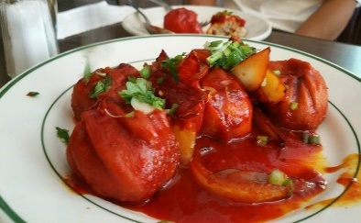
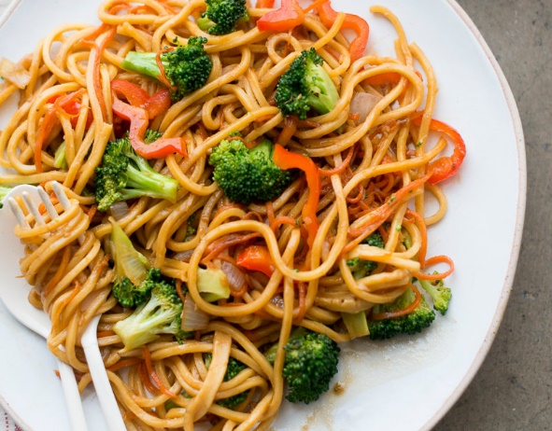
FOODS
The craving for the food keeps changing with the mood. There are many varieties in the Nepali foods. You can choose what to eat. Some of the popular and the highly preferred foods among the Nepalis….
MO:MO:
One of the most popular and liked food by every Nepalis. Easy to get locally so can be eaten as a snack ,lunch , dinner…upon you!!
You can order it in your own style either the Steam ,the Fried or diped in the soup or chilly momo. If you are a vegetarian they have a veg-momo too. Dont worry!
CHOWMEIN
The noodles boiled in water and prepared with the mixing of different spices .You can have it on your iown choice either mixed with chicken or the vegetarian way.
17311 All Rights Reserved Peekay

Slide 2
DAL BHAT POWER
The authentic nepali cuisine. Nepalis are used to eat it everyday . Either the lunch or dinner its suitable the either way.It is like an everyday food for the nepalis and family. Even the foreigners living in Nepal loves it too. Cooked in the nepali way which includes rice .dal ,meat vegetable curry ,pickles,salads.

